Slide 1

Introduction to using R for Spatial Analysis
Thu 3rd March, 9:30am – 4pm
Dr Nick Bearman
@nickbearmanuk
Department of Geography and Planning

Slide 2


Introduction to Spatial Data &
Using R for Spatial Analysis
Tues 14 Feb 2017
10:00am – 4:00pm/4:30pm
Dr Nick Bearman
@nickbearmanuk
Log on: Username: cdrc-x (computer name initial) Pw: cdrc

Slide 3
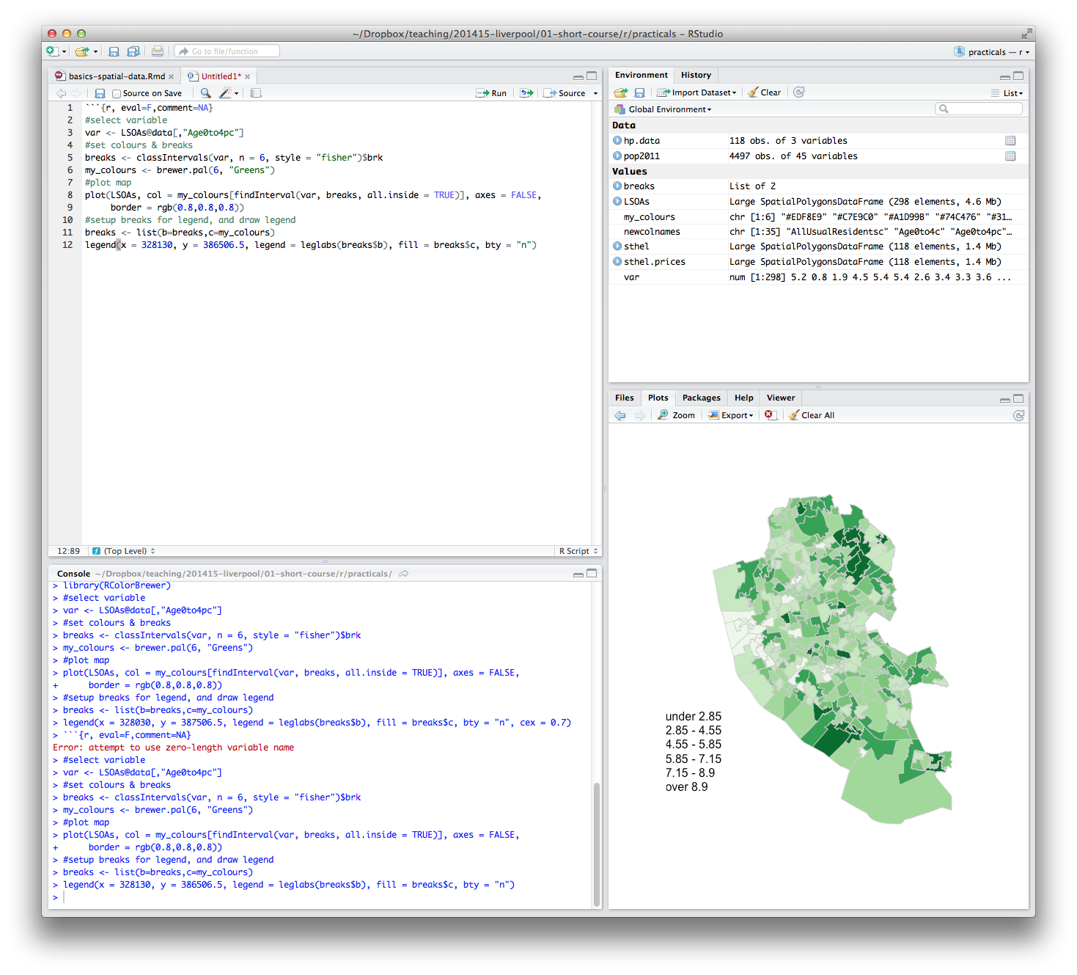
Welcome
Introductions
Who are you?
What GIS have you used before?
What do you want to get from the course?

Slide 4
What will you get from the course?
Background on R and spatial data
Load spatial data
Create a map

Slide 5
What will you get from the course?
Appropriate methods of visualizing data
Basic analysis
Using your own data
Presentations etc. are
available online
Toilets
Fire Alarm
Breaks

Slide 6
Outline of the day
9:45am - 10:15am – What is GIS & R?
10:15am - 11am – Prac. 1 Intro to GIS & R
11:00am - 11:30am – Classification
11:45am - 12:30pm – Prac. 1 Intro to GIS & R
12:30pm - 1:30pm – Lunch
1:30pm - 1:45pm – Recap and Making Maps
1:45pm - 3:00pm – Practical 2 Analysis
3:00pm - 3:15pm – Coffee
3:15pm - 4pm/4:30pm – Practical 2 BYOD
Notes:
Practical 2 – Bring Your Own Data
6

Slide 7
Outline of the day
10:15am – 11:00am – What is GIS & R?
11:00am – 11:30am – Prac. 1 Intro to GIS & R
11:30am – 12:00pm – Classification
12:30pm – 12:30pm – Prac. 1 Intro to GIS & R
12:30pm – 1:30pm – Lunch
1:30pm - 1:45pm – Recap and Making Maps
1:45pm – 3:00pm – Prac. 2 Analysis
3:00pm – 3:15pm – Coffee
3:15pm – 4pm/4:30pm – Prac. 2 BYOD

Slide 8
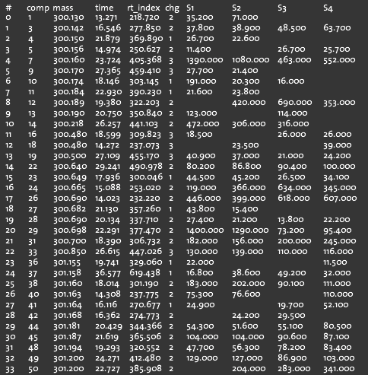
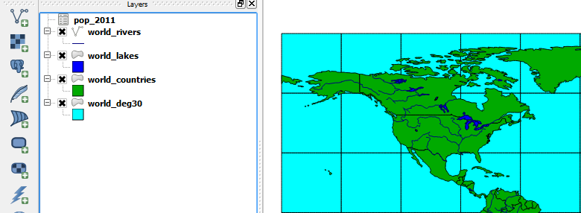
What is GIS?
Turning (spatial) data into information
Using this information to answer questions
How have housing conditions changed in the past ten years?
http://www.flickr.com/photos/dsleeter_2000/3097476532 & ESRI Course “Teaching with GIS”

Slide 9
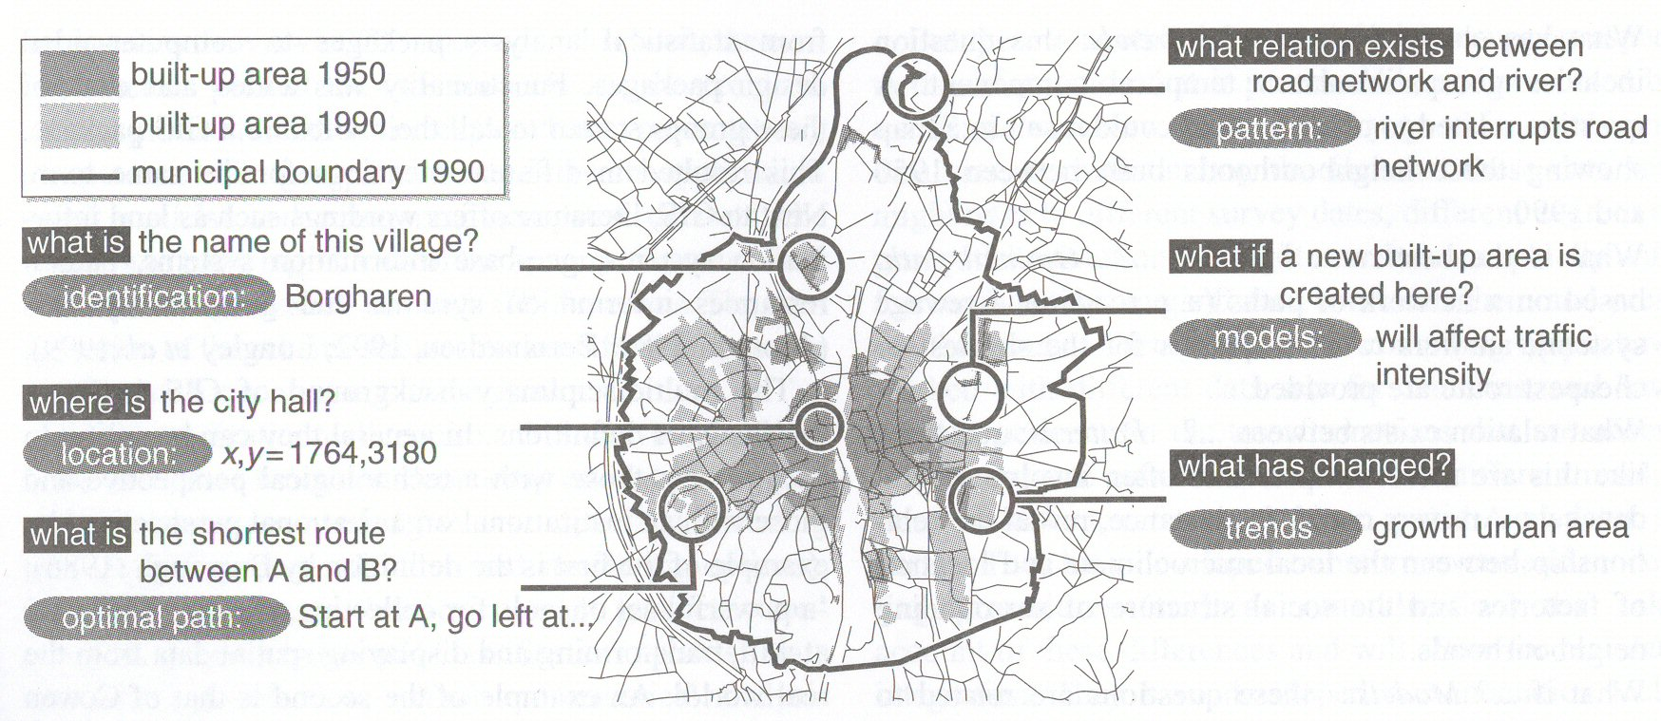
Types of questions a GIS can answer
Source: Kraak & Ormeling (2003) p.7.
Notes:
We can use a GIS for an almost infinite range of purposes, including…
-Location-based queries (e.g. where is the community centre?)
Relationship-based queries (e.g. where is the nearest Well or bore hole?)
Network analysis (e.g. what is the shortest route between A and B?)
Trend analysis (e.g. how has land use changed between time A and time B?)
3D visualisation (e.g. displaying 3d flood models)
This course will give you experience in using all three levels of using geographic information systems.
9

Slide 10
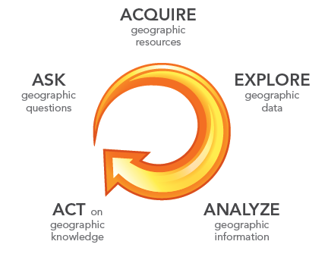
What is GIS?
http://www.flickr.com/photos/dsleeter_2000/3097476532 & ESRI Course “Teaching with GIS”

Slide 11
GIS – Geographic Information Systems
Almost all human activities and decisions involve an important geographic component
the ‘where?’
Working with geographic information involves unique, complex and difficult choices
Why we need specialized software
organize and store
access and retrieve
manipulate and synthesize
apply to the solution of problems

Slide 12
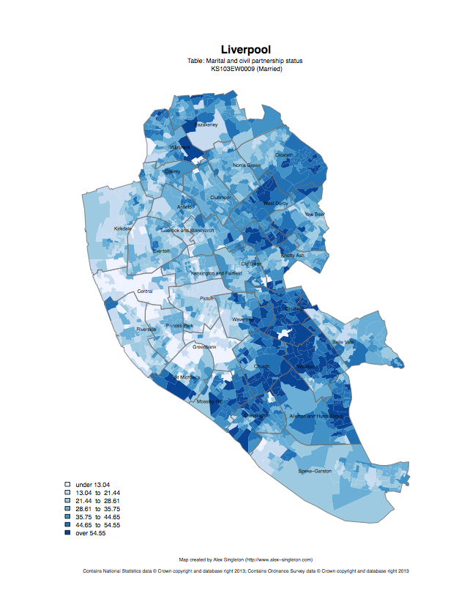
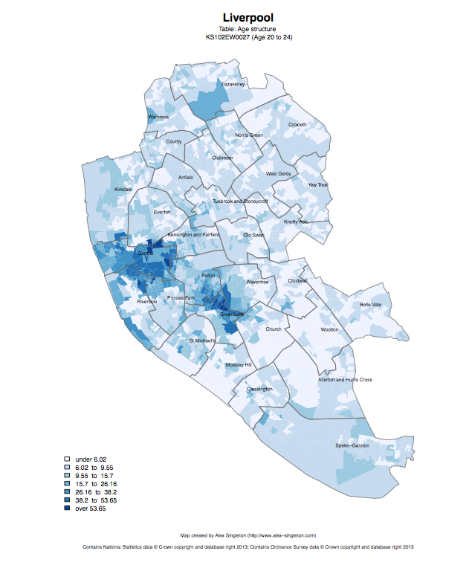
Census 2011
Married
Age structure – 20 to 24
http://www.alex-singleton.com/r/2014/02/05/2011-census-open-atlas-project-version-two/

Slide 13
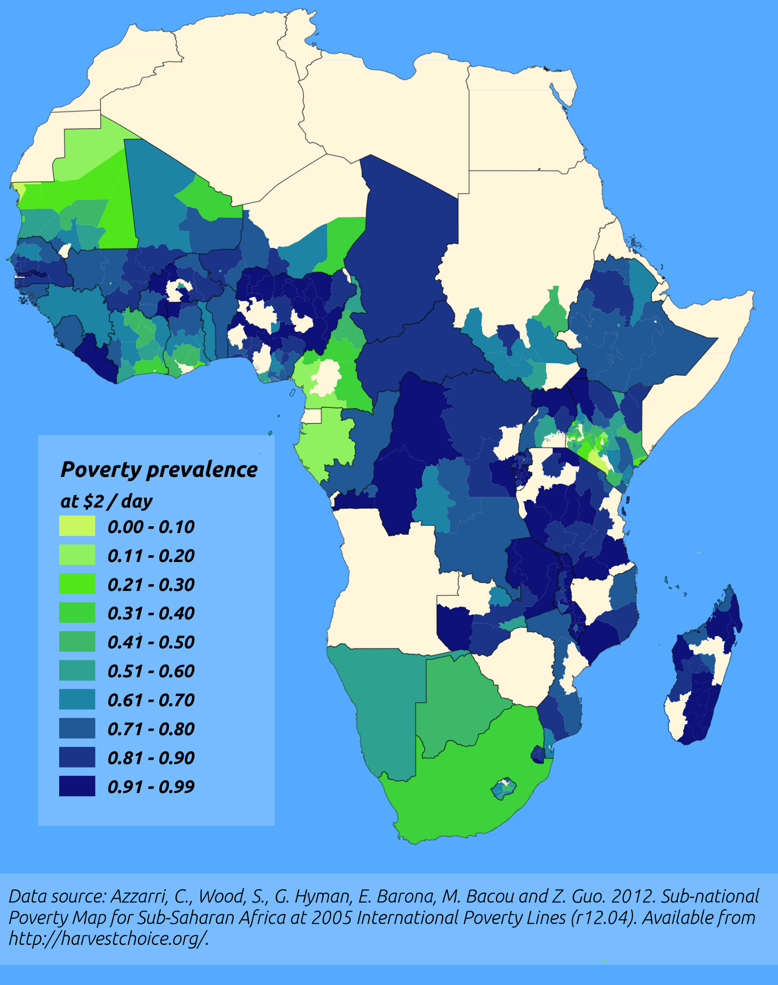
http://pvanb.wordpress.com/2012/05/09/poverty-maps-on-harvestchoice/

Slide 14





CDRC
ESRC, Getting more Information from Retail Data
Outreach – Stakeholder Users
Engagement – PhD / MSc / Training
Data and Services
Open, Safeguarded, Controlled

Slide 15

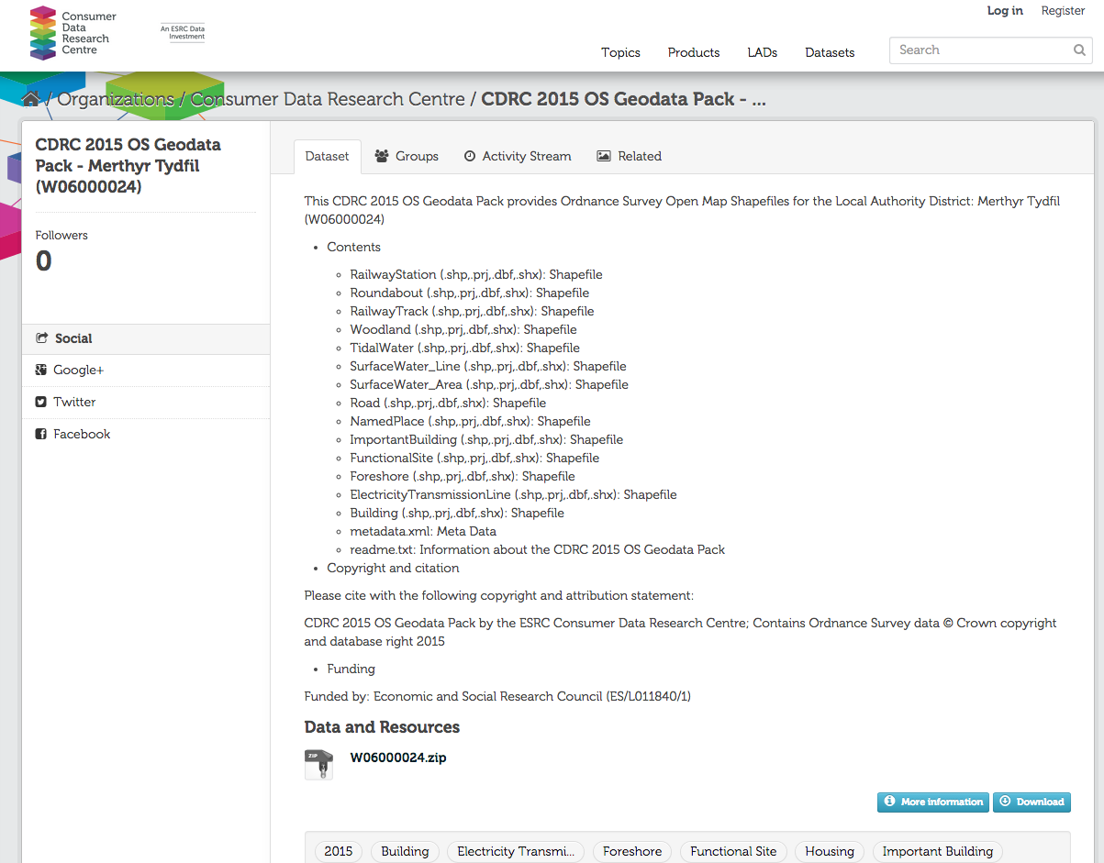
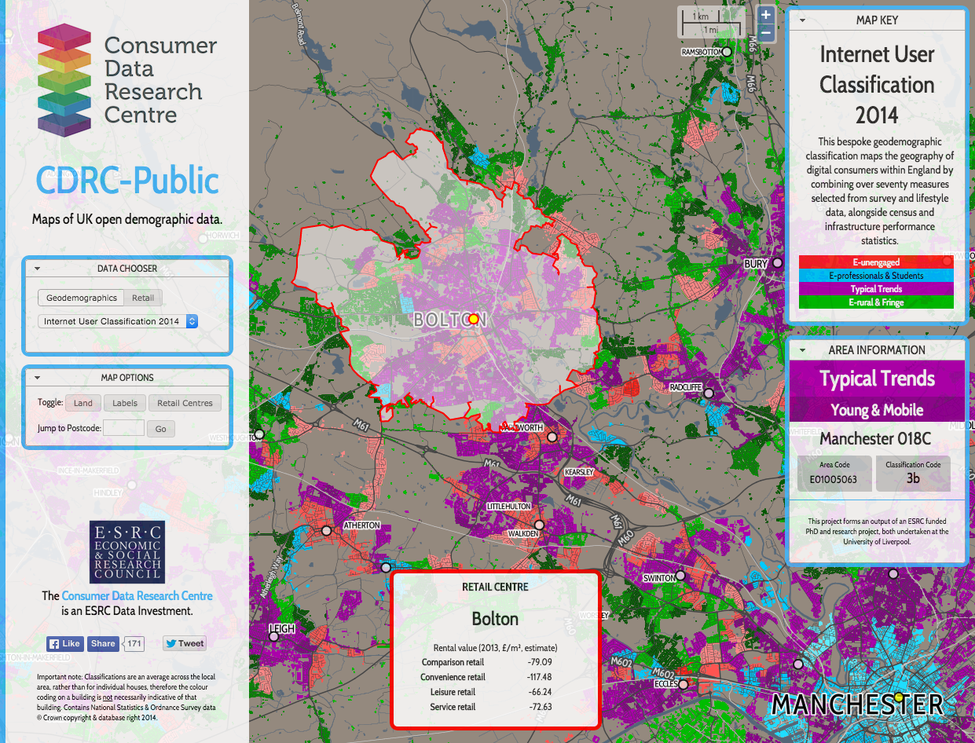
CDRC Services
Open
data.cdrc.ac.uk
maps.cdrc.ac.uk

Slide 16
ADRN-E
Administrative Data Research Network (ADRN) established by ESRC 2014
One centre in each UK country – Administrative Data Research Centre for England (ADRC-E)
Collaboration between Southampton/Bloomsbury/Office for National Statistics (ONS)

Slide 17
Administrative Data
Data collected by government for routine administrative purposes
e.g. health, education, crime, benefits,
Many key policy-related research questions unlocked by potential linked administrative data
Access arrangements complex, requiring regulation, training, secure access environments, etc.

Slide 18


Slide 19
ADRN-E
Secure laboratory infrastructure for analysis of de-identified linked administrative data
Research programme
Substantive and methodological projects
Services
Support for approved ADRN projects
Training and outreach – including today’s course!

Slide 20
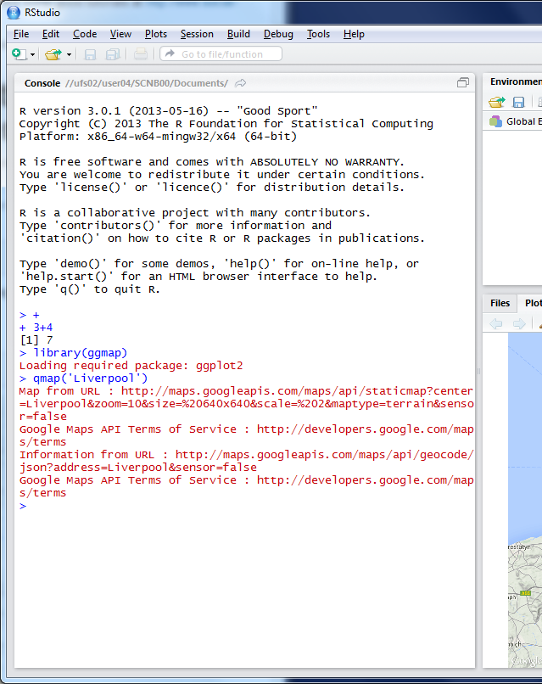
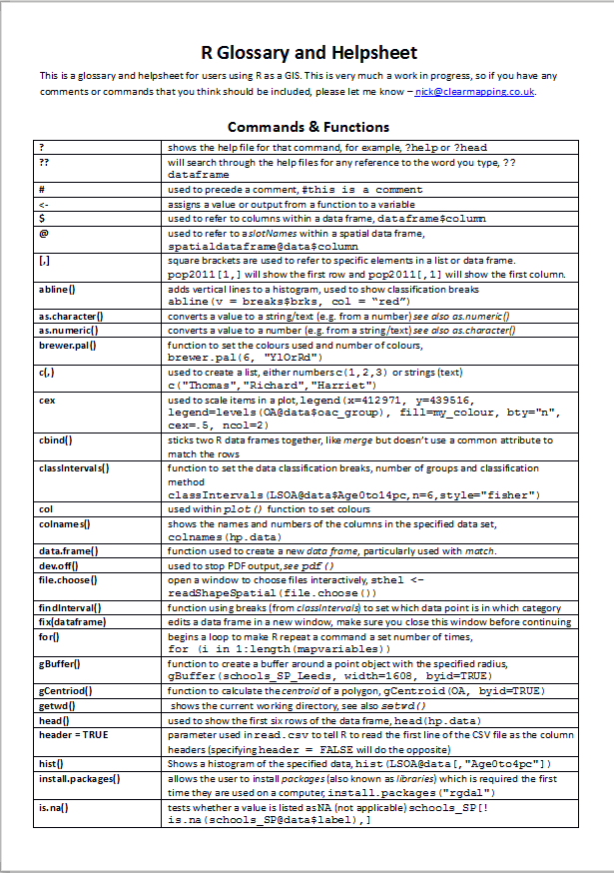

R as a GIS
Command line driven, rather than GUI
Disadvantages
Remembering commands
glossary
Steeper
learning
curve

Slide 21
R as a GIS
Advantages
Easy to record what you did and repeat specific pieces of work
Lots of reproducible examples on the web
Easily scriptable.
134,567 maps? easy!
2011 Census Open Atlas
http://www.alex-singleton.com/r/2014/02/05/2011-census-open-atlas-project-version-two/

Slide 22
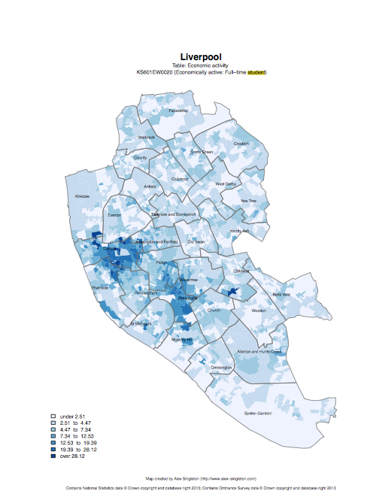

R in Action
Economically active – Full-time students

Slide 23
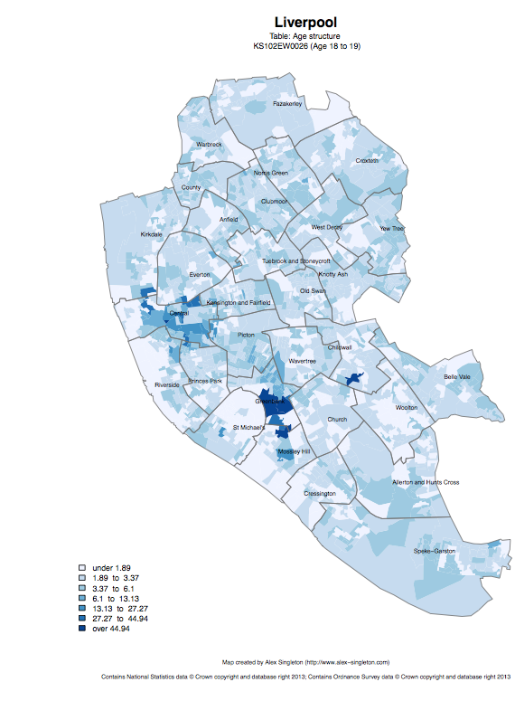
Age structure – 18 to 19
Age structure – 20 to 24

Slide 24
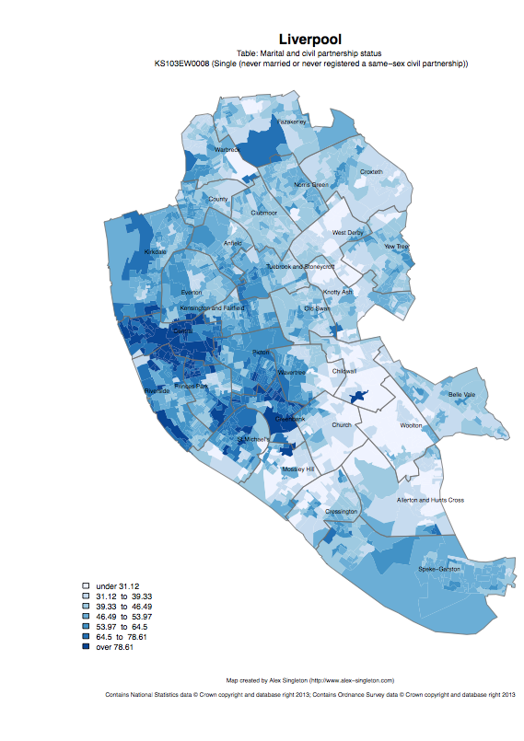
Single
Married

Slide 25
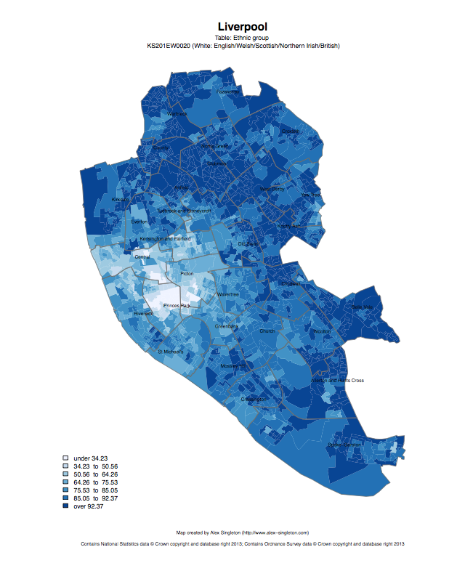
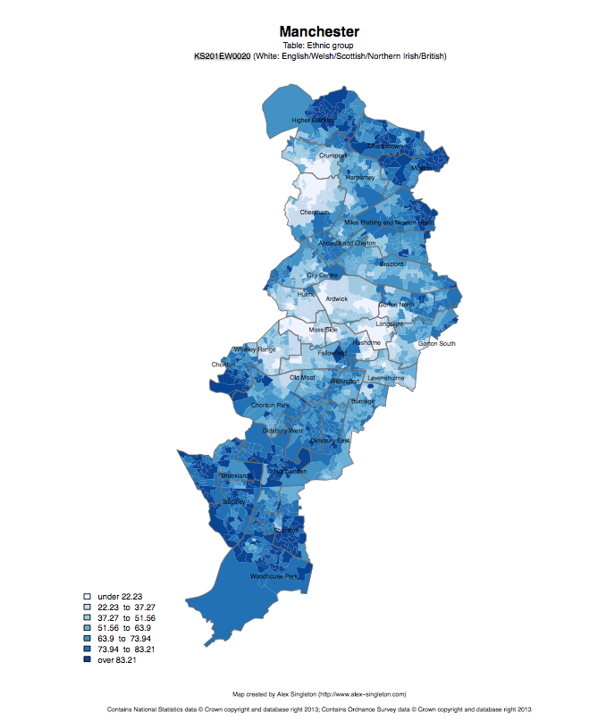
Ethnic group: white

Slide 26
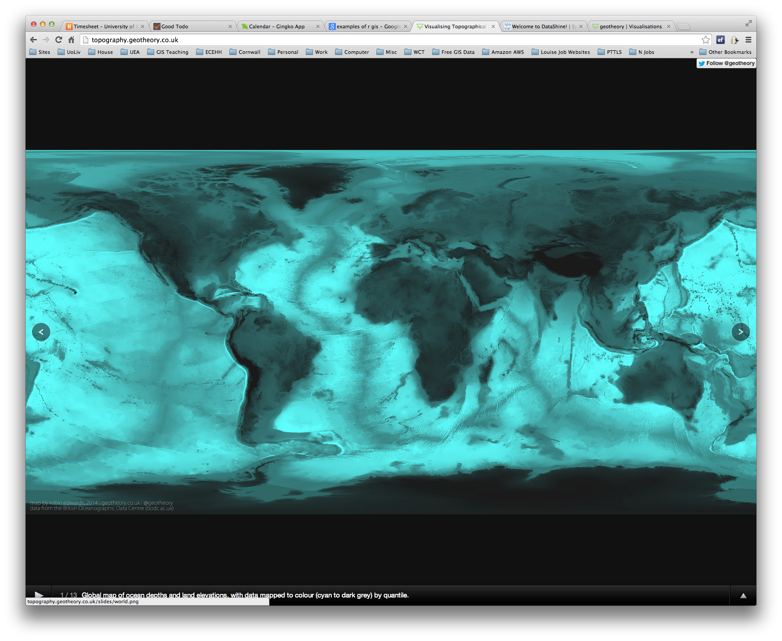

R as a GIS
Topography
http://topography.geotheory.co.uk/

Slide 27




Other GIS software?
R is very different to ArcGIS, but can do many of the same operations
R is free (as is QGIS)
R is increasingly popular in academic sector
All can be useful

Slide 28
Projections and
Coordinate Systems
Who has heard of these?
Why are they important?
Latitude and Longitude (WGS 1984)
52°N 37’ 30.32’’ (52.6250) 1°E 14’ 2.05’’ (1.2339)
British National Grid (Eastings & Northings)
Easting: 619301 Northing: 307416

Slide 29
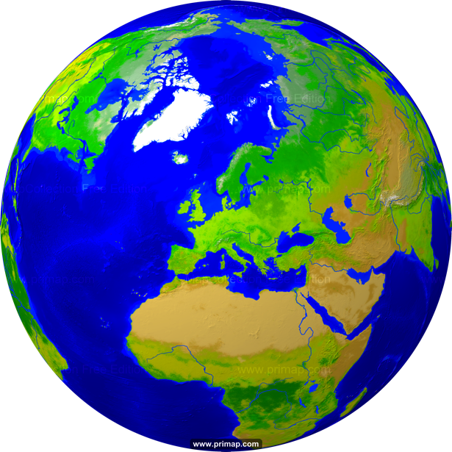
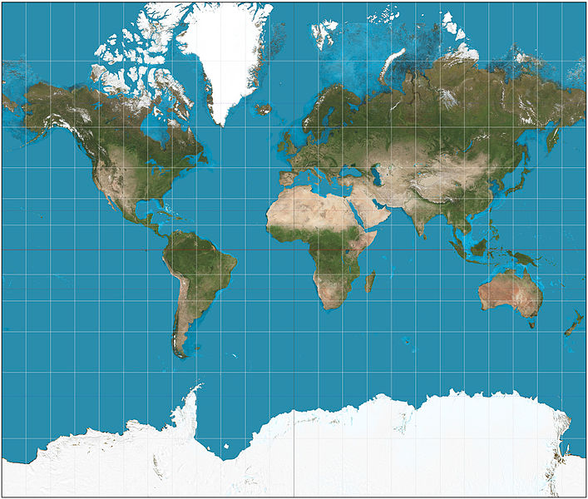
Projections
Projection – going from a sphere to a flat surface
http://www.primap.com/wsen/Maps/MapCollection/WorldMaps/Globe-(Europe-centered)-Vegetation-4000x4000.html

Slide 30

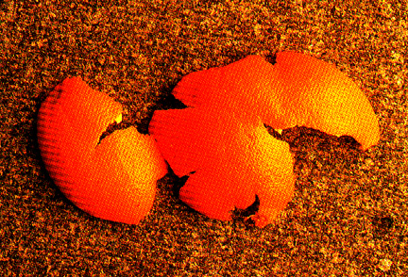
Projections
Projection – going from a sphere to a flat surface
Can’t maintain all of shape, area, angles (bearing) and distance
Video - http://flowingdata.com/2016/12/08/physical-demo-of-how-all-maps-are-wrong/
http://krygier.owu.edu/krygier_html/geog_353/geog_353_lo/geog_353_lo05.html
http://www.hdwallpapersos.com/orange-fruit-hd-wallpapers.html

Slide 31
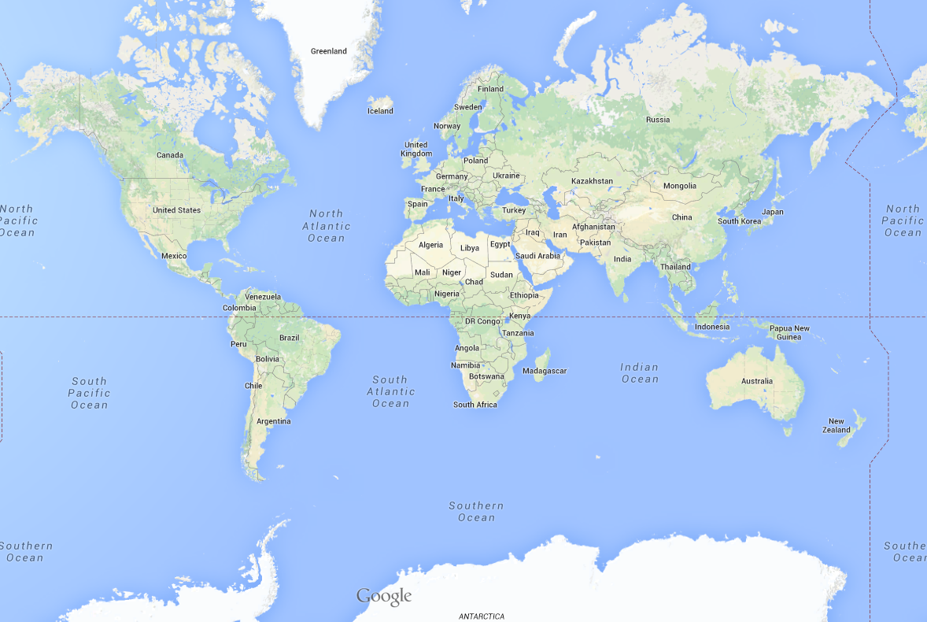
This file is licensed under the Creative Commons Attribution-Share Alike 3.0 Unported license. http://en.wikipedia.org/wiki/File:Mercator_projection_SW.jpg
Mercator projection

Slide 32
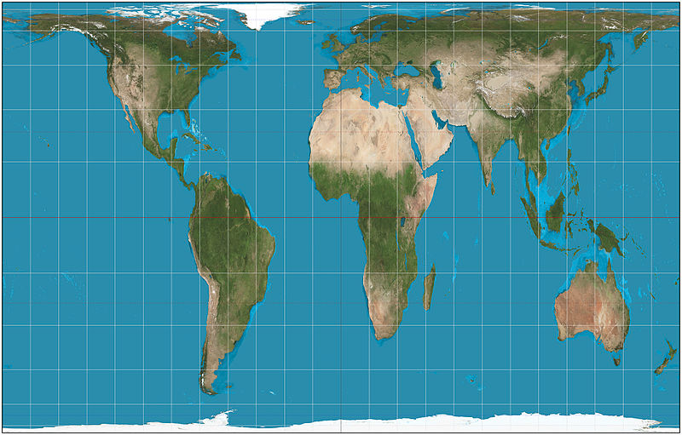
This file is licensed under the Creative Commons Attribution-Share Alike 3.0 Unported license. http://en.wikipedia.org/wiki/File:Mercator_projection_SW.jpg
Mercator projection
Gall-Peters projection
This file is licensed under the Creative Commons Attribution-Share Alike 3.0 Unported license. http://en.wikipedia.org/wiki/File:Gall%E2%80%93Peters_projection_SW.jpg

Slide 33
Africa: 30 million sq km
Greenland: 2 million sq km

Slide 34
Projections etc.
Africa: 30 million sq km
Greenland: 2 million sq km

Slide 35
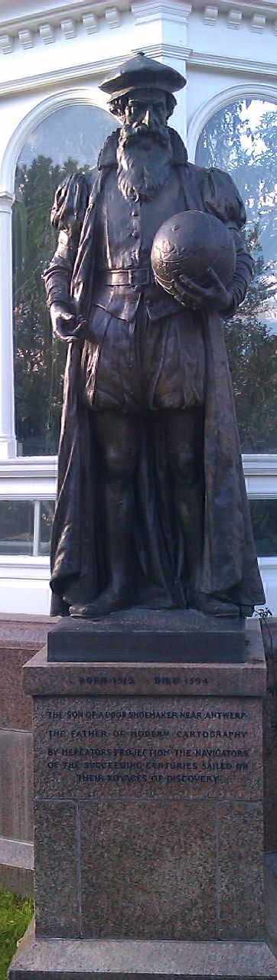
Mercator
“The Father of Modern Cartography”
By Mercator’s Projection the navigators of the succeeding centuries sailed
1569
Notes:
Maintains angle but not area.
35

Slide 36
Projections etc.
Reprojection
Can’t maintain
area and angles
Peters: area
Mercator: angles

Slide 37
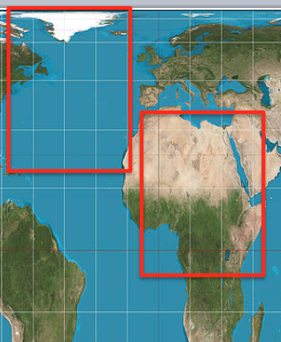
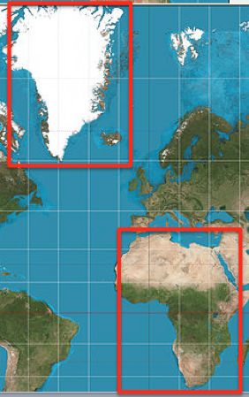
Why are Projections important?
The map(s) may not be as they appear
Data may appear in the wrong place

Slide 38
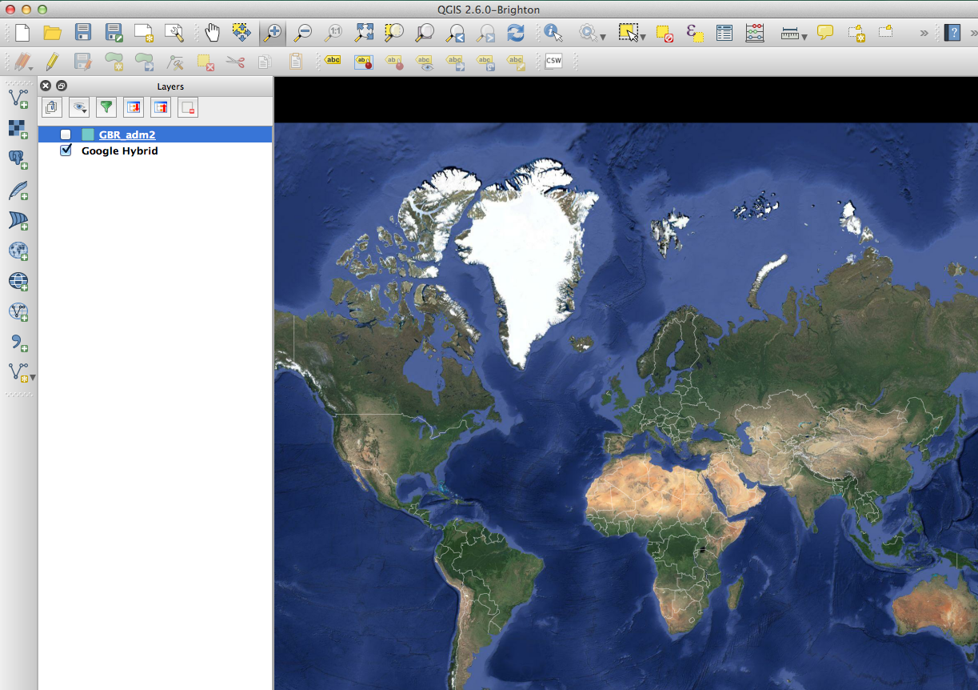

Slide 39
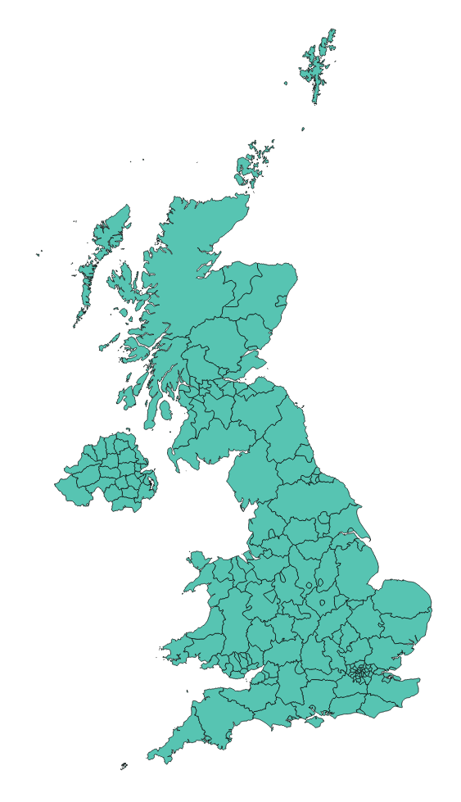

Slide 40
Why are Projections important?
The map(s) may not be as they appear
Data may appear in the wrong place
Coordinate Systems

Slide 41
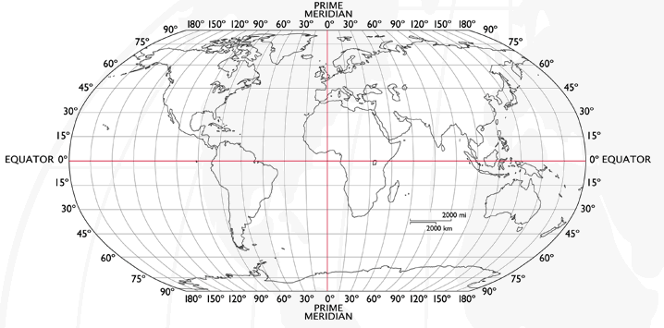
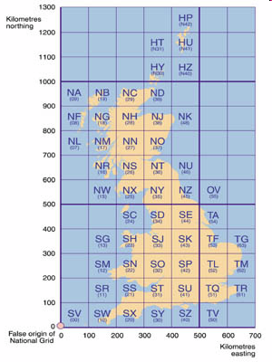
Coordinate Systems
Latitude and Longitude (WGS 1984) EPSG = 4326
52°N 37’ 30.32’’ (52.6250) 1°E 14’ 2.05’’ (1.2339)
British National Grid (Eastings & Northings)
Easting: 619301 Northing: 307416 EPSG = 27700
Why is it important?
Some data uses uses WGS84
LSOA use BNG (Eastings/Northings)
Need to convert between the two
Notes:
41
-Coordinate Systems are derived from projections and are used to give coordinates (numbers) to locations on the Earth’s surface
-Best if your data is all in the same coordinate system (otherwise the coordinates might be slightly different for the same location), but ArcMap can convert between them
-Most common:
-Lat/Long (also WGS 1984) used by most GPS
-BNG (British National Grid) very common in UK data – Ordnance Survey format.
-Most important – are all your data in the same coordinate system?
-ArcMap can convert, but often if your data appears in the wrong place, it is because there is something wrong with the coordinate system.
http://www.worldatlas.com/webimage/testmaps/latslongs.htm
http://www.ordnancesurvey.co.uk/oswebsite/gps/information/coordinatesystemsinfo/guidetonationalgrid/page13.html
http://www.ordnancesurvey.co.uk/oswebsite/gps/information/coordinatesystemsinfo/guidetonationalgrid/page8.html

Slide 42
Joining
Area ID
1
2
3
4
5
14
7
8
11
Area ID | Deprivation
1 | High
2 | High
3 | High
4 | Average
5 | Average
6 | Average
7 | Low
8 | Low
9 | Low
10 | High
11 | Low
12 | High
13 | High
14 | Average
15 | Average
1
2
3
14
4
7
5
8
11
Data
Polygons
Linked Data similar to Joining
More tomorrow, or ask me for details
Lookup

Slide 43
1
Area ID | Deprivation
1 | High
2 | High
3 | High
4 | Average
5 | Average
14 | Average
7 | Low
8 | Low
11 | Low
2
3
14
4
7
5
8
11
High Deprivation
Average Deprivation
Low Deprivation

Slide 44
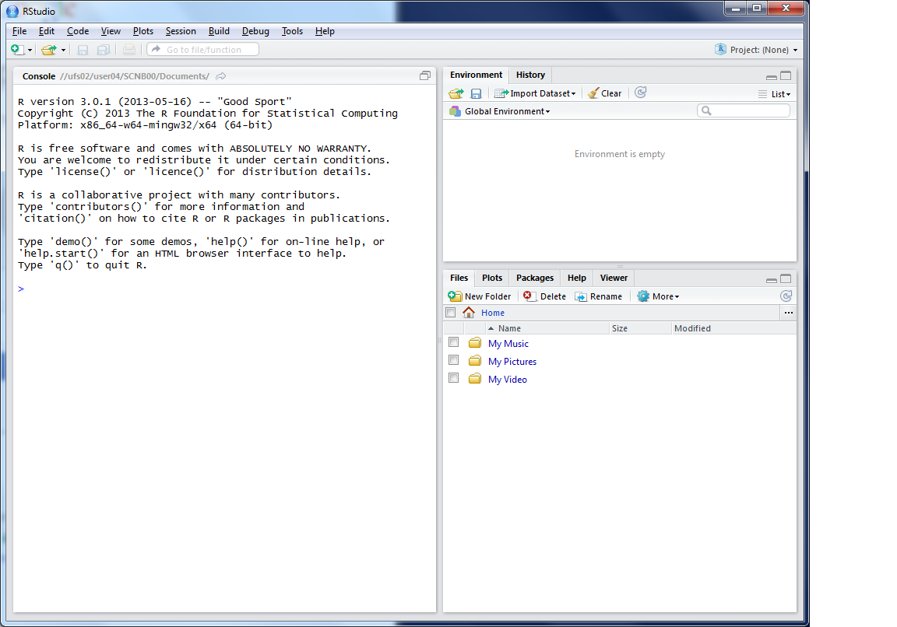
This lists the variables you have
This is the console where you can type in commands
Here will show either your files (the files tab) or your plots (the plots tab)

Slide 45
Working Directory
R uses a ‘working directory’ to store your files in
You might have a different one for each project / piece of work
e.g. M:\Documents\GIS
setwd(“M:/Documents/GIS”)
/home is the default but this won’t work
Use /home/$username/GIS

Slide 46
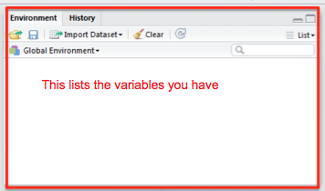
Variables
R uses variables to
store information –
listed in your ‘workspace’ (top-right)
When you close R Studio, save workspace
house.prices <- c(120,150,212, 99,199,299,159)

Slide 47
Variables and Assignments
house.prices
<-
c(120,150,212,99,199,299,159)

Slide 48
Variables and Assignments
house.prices
<-
c(120,150,212,99,199,299,159)

Slide 49
Variables and Assignments
house.prices
<-
c(120,150,212,99,199,299,159)

Slide 50
Variables and Assignment
motorways
<-
readShapeSpatial('meridian-2/ motorway_polyline’, proj4string = CRS("+init=epsg:27700"))
See glossary for details
Notes:
50

Slide 51
Variables and Assignment
motorways
<-
readShapeSpatial('meridian-2/ motorway_polyline’, proj4string = CRS("+init=epsg:27700"))
See glossary for details
Notes:
51

Slide 52
Variables and Assignment
motorways
<-
readShapeSpatial('meridian-2/ motorway_polyline’, proj4string = CRS("+init=epsg:27700"))
See glossary for details
Notes:
52

Slide 53
Variables and Assignment
motorways
<-
readShapeSpatial('meridian-2/ motorway_polyline’, proj4string = CRS("+init=epsg:27700"))
See glossary for details
Notes:
53

Slide 54
Variables and Assignment
readShapeSpatial('meridian-2/ motorway_polyline’, proj4string = CRS("+init=epsg:27700"))
Notes:
54

Slide 55
Variables and Assignment
readShapeSpatial(
’meridian-2/ motorway_polyline’
,
proj4string = CRS("+init=epsg:27700")
)
Notes:
55

Slide 56
Variables and Assignment
readShapeSpatial(
’meridian-2/ motorway_polyline’
,
proj4string = CRS("+init=epsg:27700")
)
Function
Notes:
56

Slide 57
Variables and Assignment
readShapeSpatial(
’meridian-2/ motorway_polyline’
,
proj4string = CRS("+init=epsg:27700")
)
Parameter
Notes:
57

Slide 58
Variables and Assignment
readShapeSpatial(
’meridian-2/ motorway_polyline’
,
proj4string = CRS("+init=epsg:27700")
)
Parameter
Notes:
58

Slide 59
Variables and Assignment
motorways
<-
readShapeSpatial('meridian-2/ motorway_polyline’, proj4string = CRS("+init=epsg:27700"))
See glossary for details
Case sensitive
Motorways ≠ motorways ≠ mOtOrWaYs
Notes:
59

Slide 60
Data Formats
Data frames are like a table or spreadsheet
dataframe[rows,cols]
dataframe[1,] first row
dataframe[,1] first col

Slide 61
Practical Approach
(Primarily) self-led practical
Good to explore the options
Ask questions as we go through
Try things
Use the help ?command

Slide 62
Typing out Code
Log on: Username: cdrc-X Pw: cdrc
Why do I make you type out code?
Helps the learning process
Make you think about what the code does
(but you can copy/paste long bits)
Optional Exercises
Red and Green post-its
Breaks

Slide 63
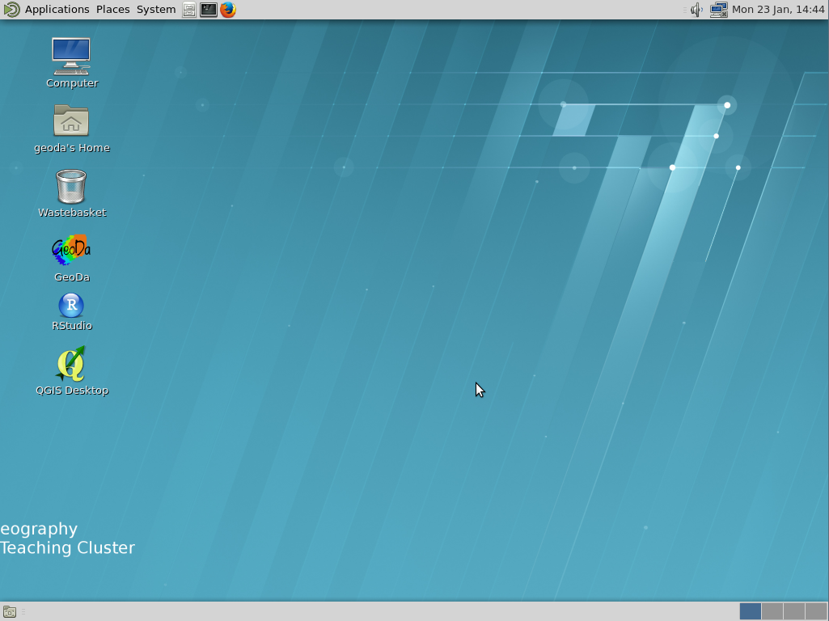

Slide 64
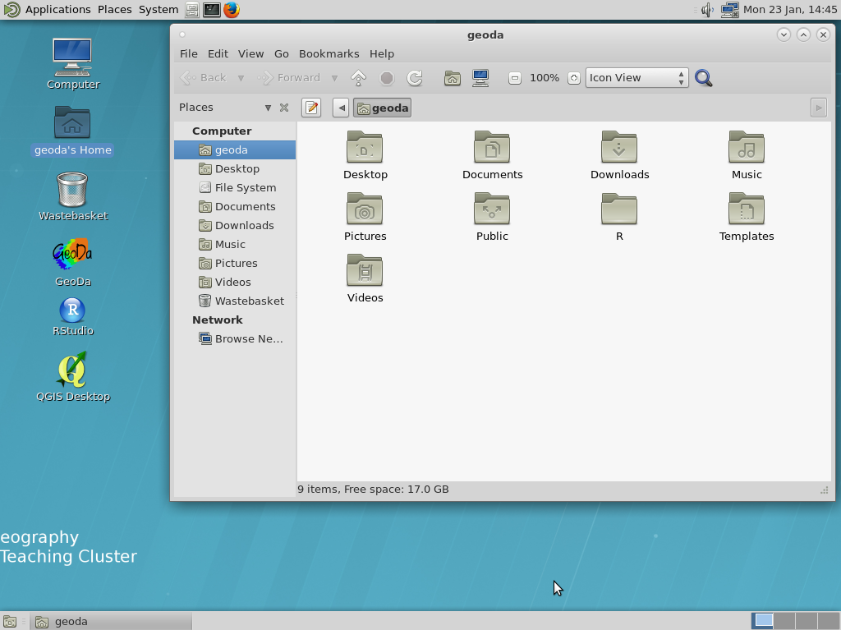

Slide 65
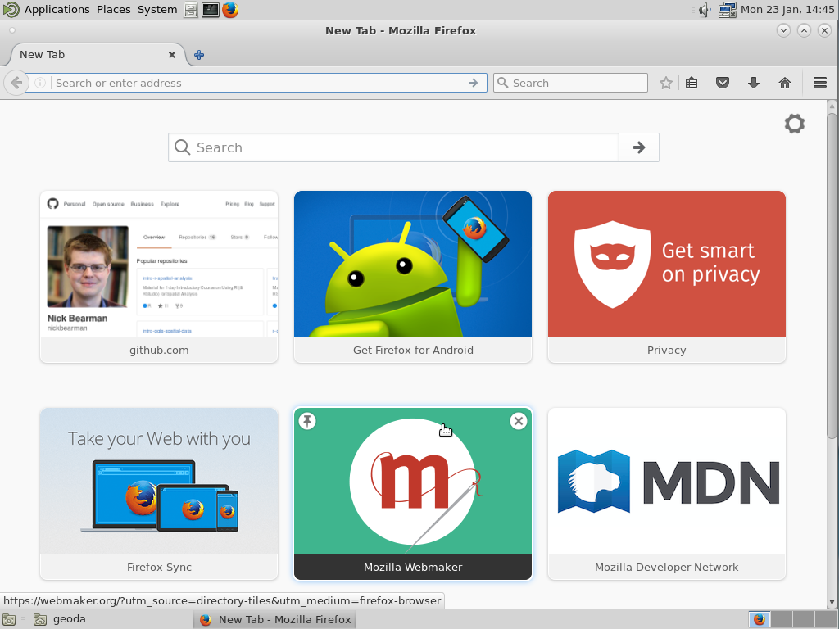

Slide 66
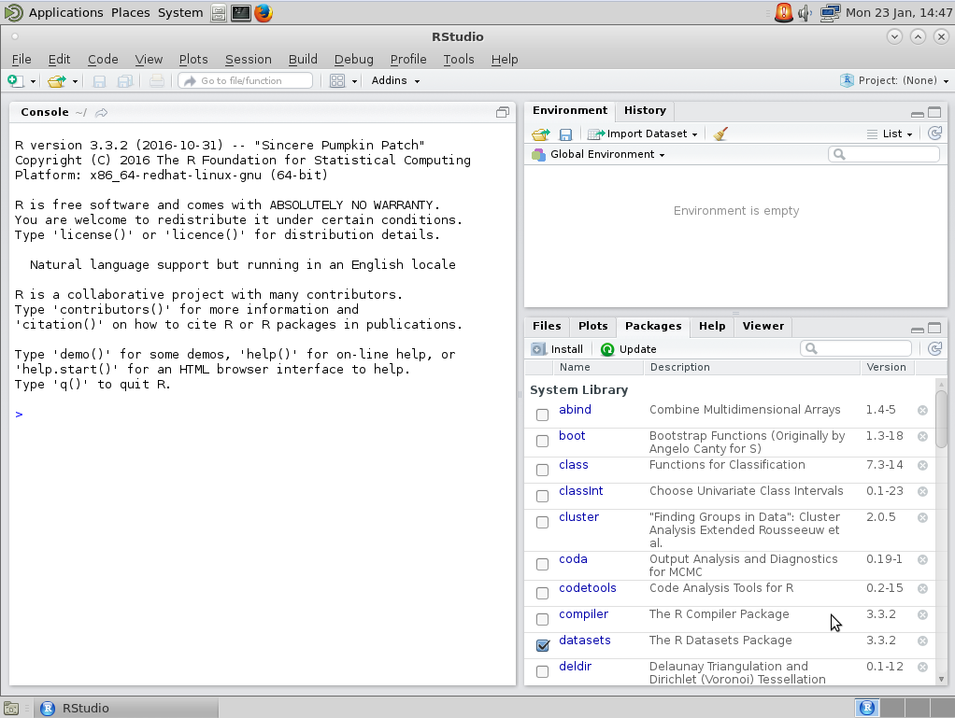

Slide 68
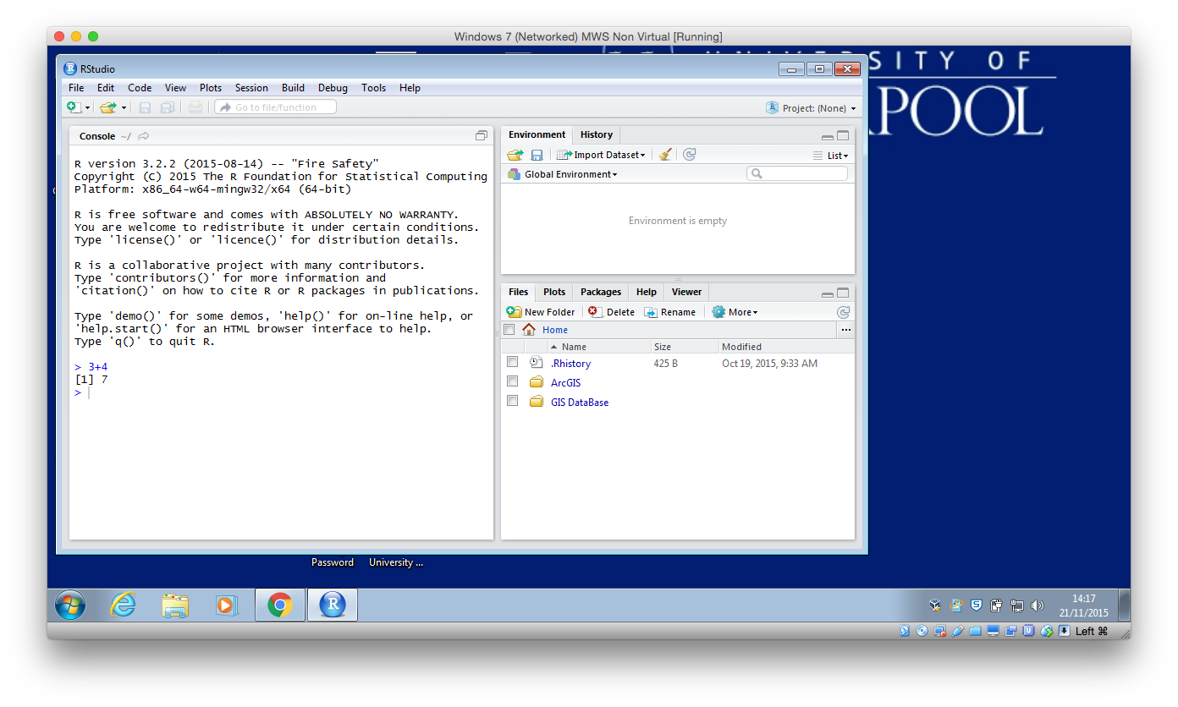
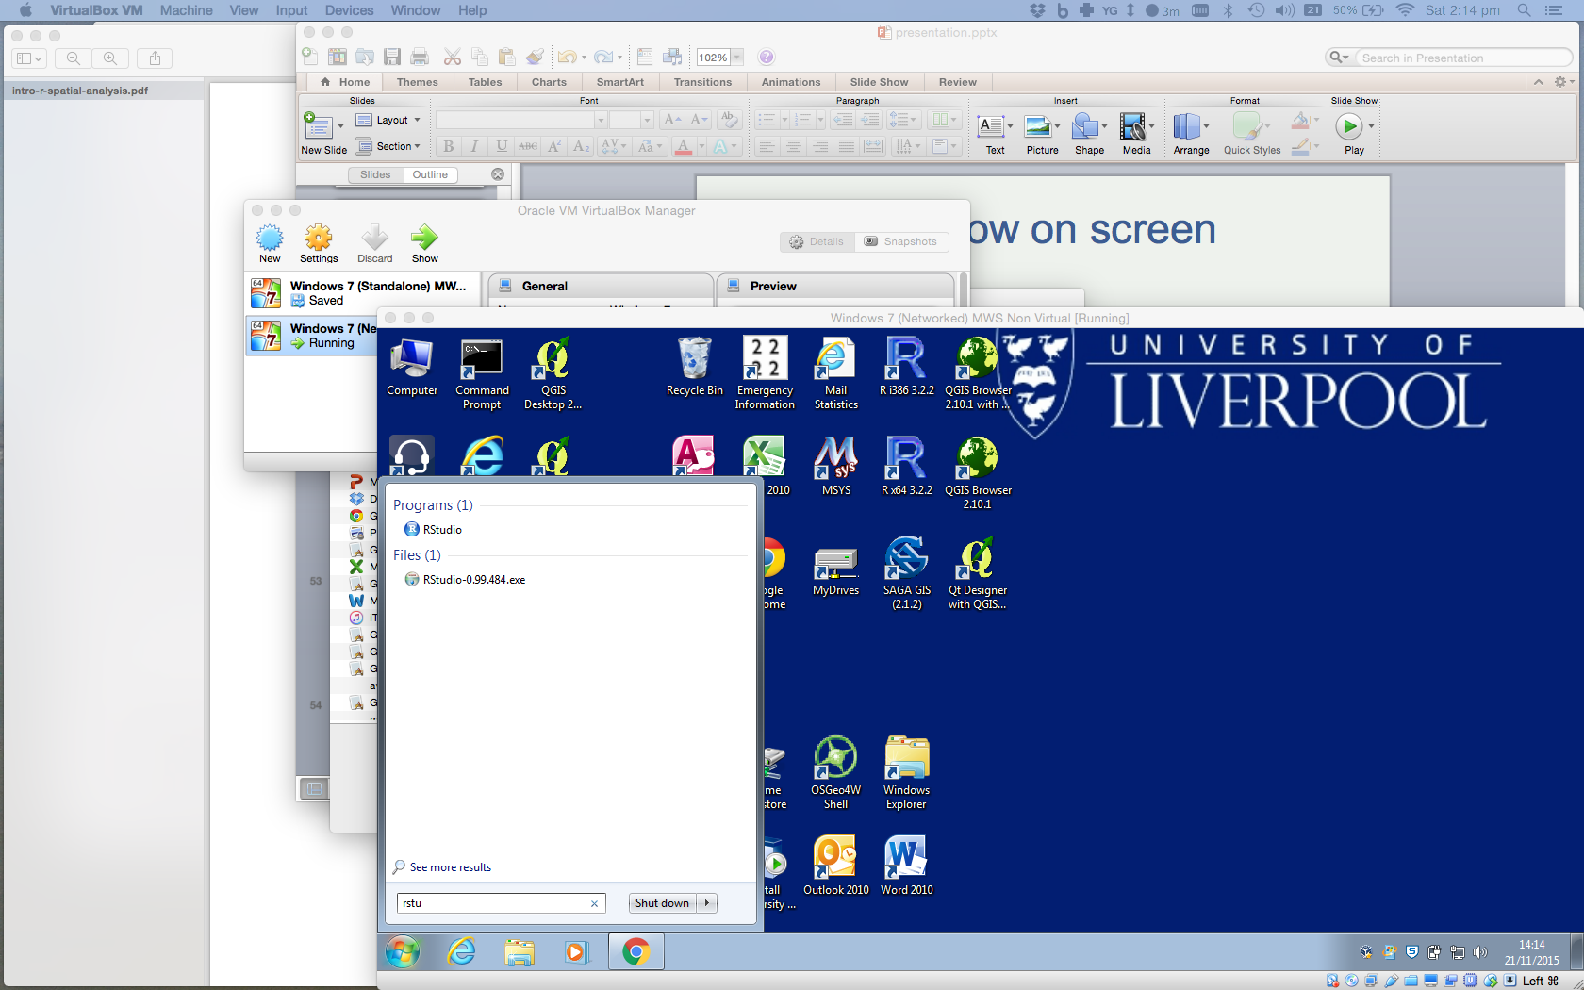
Load R

Slide 70
Outline of the day
10:15am – 11:00am – What is GIS & R?
11:00am – 11:30am – Prac. 1 Intro to GIS & R
11:30am – 12:00pm – Classification
12:30pm – 12:30pm – Prac. 1 Intro to GIS & R
12:30pm – 1:30pm – Lunch
1:30pm - 1:45pm – Recap and Making Maps
1:45pm - 3:00pm – Prac. 2 Analysis
3:00pm - 3:15pm – Coffee
3:15pm - 4pm/4:30pm – Prac. 2 BYOD

Slide 71
Outline of the day
10:00am - 10:25am – What is GIS & R?
10:25am - 11:15am – Prac. 1 Intro to GIS & R
11:15am - 11:45am – Classification
11:45am - 12:30pm – Prac. 1 Intro to GIS & R
12:30pm - 1:15pm – Lunch
1:15pm - 1:45pm – Recap and Making Maps
1:45pm - 3:00pm – Prac. 2 Analysis
3:00pm - 3:15pm – Coffee
3:15pm - 4pm/4:30pm – Prac. 2 BYOD

Slide 72
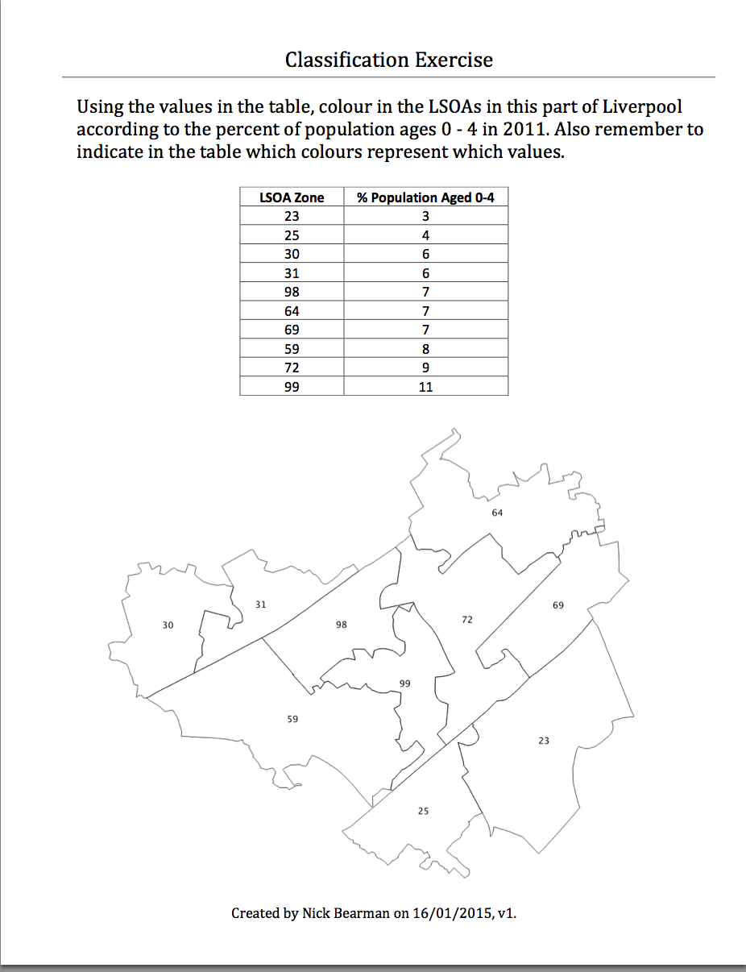
Classification
Colour in the values for Age (10 min)
Discuss your choices

Slide 73
Classification
Colour in the values for Age (10 min)
Discuss your choices
Colours
Classes

Slide 74
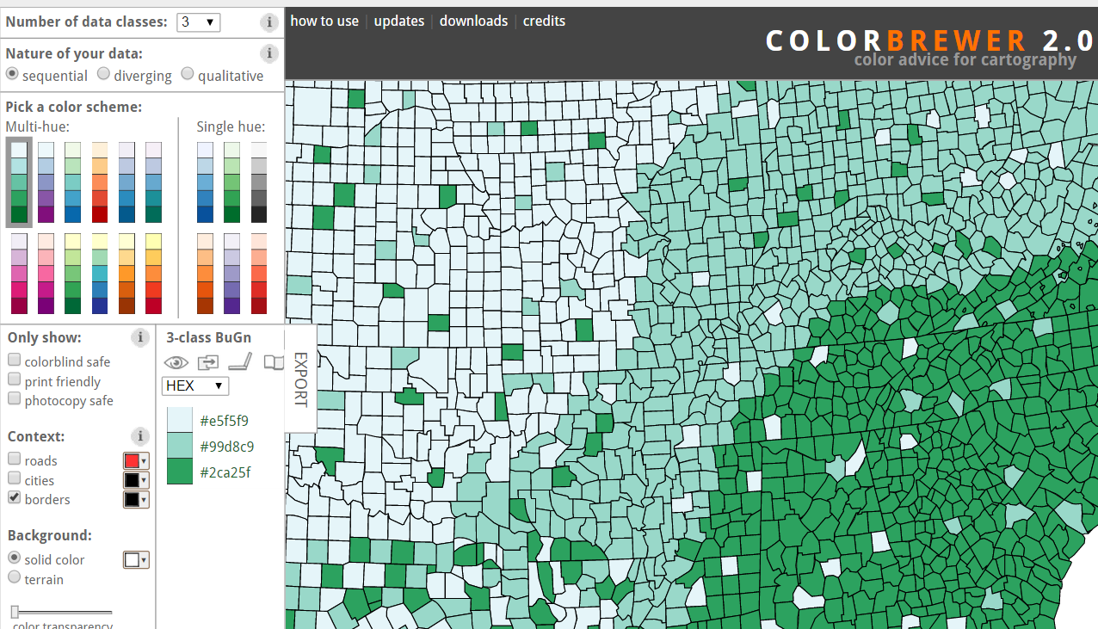
Map Design: Classification
Choropleth maps have colours
How do you choose the colours?
Why is this important?
Output
User
colorbrewer.org

Slide 75
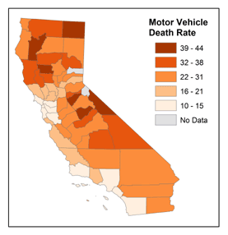
Map Design: Classification
Choropleth maps have classes
How do you choose the classes?
Why is this important?
© 2014 The Pennsylvania State University, https://www.e-education.psu.edu/geog486/l4_p7.html#classification_schemes

Slide 76
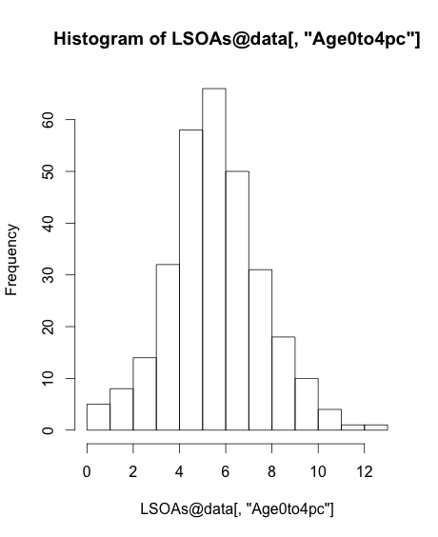
Map Design: Classification
[,"Age0to4pc"]

Slide 77
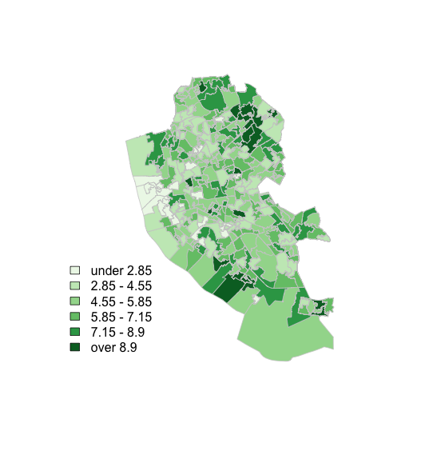
Map Design: Classification

Slide 78
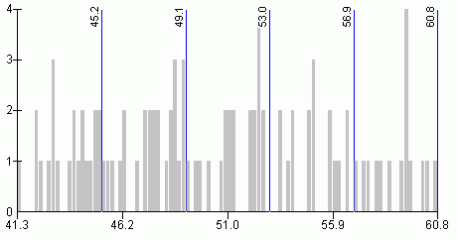
Map Design: Classification
s
http://www.directionsmag.com/entry/choropleth-mapping-with-exploratory-data-analysis/123579

Slide 79
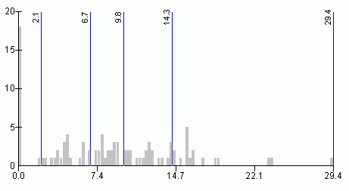
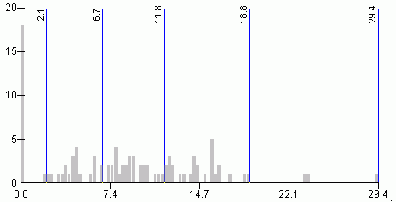
Quantiles
- “equal sized data subsets”
sN
Natural Breaks
reduce variance
within class
increase variance
between classes
http://www.directionsmag.com/entry/choropleth-mapping-with-exploratory-data-analysis/123579

Slide 80
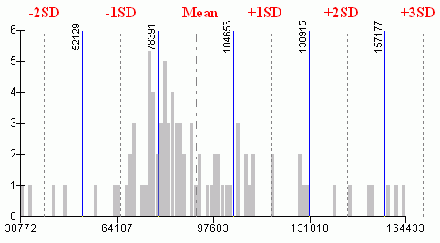
sN
Standard Deviation
R has:
fixed
sd
equal
pretty
quantile
fisher
jenks
….
(from ?classIntervals)
http://www.directionsmag.com/entry/choropleth-mapping-with-exploratory-data-analysis/123579
Notes:
80

Slide 81
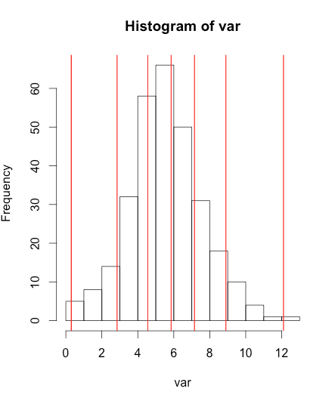
Can do this in R
var <- LSOA@data[,"Age0to4pc"]
breaks <- classIntervals(var, n = 6, style = "fisher")
hist(var)
abline(v = breaks$brks, col = "red")

Slide 82
Can do this in R
var <- LSOA@data[,"Age0to4pc"]
breaks <- classIntervals(var, n = 6, style = "fisher")
hist(var)
abline(v = breaks$brks, col = "red")

Slide 83
Can do this in R
var <- LSOA@data[,"Age0to4pc"]
breaks <- classIntervals(var, n = 6, style = "fisher")
hist(var)
abline(v = breaks$brks, col = "red")

Slide 84
Can do this in R
var <- LSOA@data[,"Age0to4pc"]
breaks <- classIntervals(var, n = 6, style = "fisher")
hist(var)
abline(v = breaks$brks, col = "red")

Slide 85
Can do this in R
var <- LSOA@data[,"Age0to4pc"]
breaks <- classIntervals(var, n = 6, style = "fisher")
hist(var)
abline(v = breaks$brks, col = "red")

Slide 86

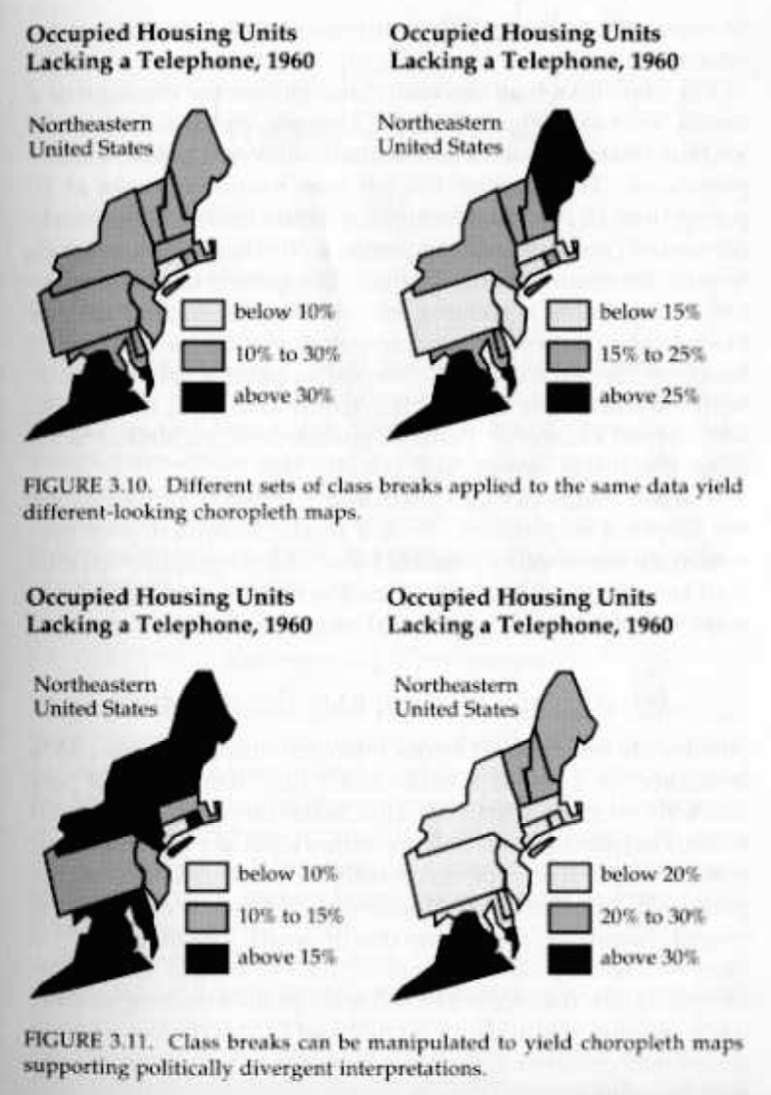
Why is it important?

Slide 87
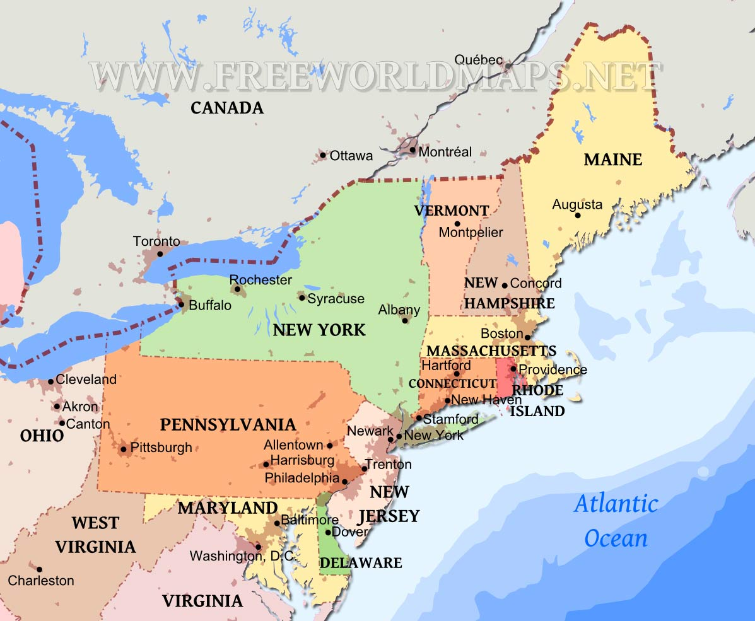
Why is it important?
http://www.markmonmonier.com/how_to_lie_with_maps_14880.htm
https://www.researchgate.net/publication/37420071_How_to_Lie_with_Maps
http://www.freeworldmaps.net/united-states/northeast/

Slide 88


Why is it important?
Age 0-4
Natural Breaks
Quantile

Slide 89
Why is it important?
Age 0-4
Natural Breaks
Quantile

Slide 90

http://www.flickr.com/photos/idvsolutions/6691496421/in/photostream/

Slide 91
http://uxblog.idvsolutions.com/2011/10/telling-truth.html

Slide 92

R Scripts
Why use scripts?
Easier to correct code
Can easily re run sections of code, or all code if you need to start again
Good to enable you to reload data etc. if you move machines, or don’t
have your workspace
saved

Slide 93
This is where you can write scripts
This lists the variables you have
Link to survey:
Here will show either your files (the files tab) or your plots (the plots tab)
This is the console where you can type in commands

Slide 94
Ctrl-Enter to run line/selection

Slide 95
Working Directory

Slide 96
Code recap
Useful tips
Up arrow in the console shows you the previous command
History contains a history of all commands
Plot window has a back arrow, and an export option
Scripts
Tab completion, libraries

Slide 97
Code debugging
R error messages can be cryptic
Remember
case sensitive
picky about , [ ] ( )
typos
Error in getinfo.shape(fn) : Error opening SHP file can’t find shapefile
Error: could not find function "readShapeSpatial” can’t find function
See glossary helpsheet – and let me know what to add!

Slide 99
Outline of the day
10:15am – 11:00am – What is GIS & R?
11:00am – 11:30am – Prac. 1 Intro to GIS & R
11:30am – 12:00pm – Classification
12:30pm – 12:30pm – Prac. 1 Intro to GIS & R
12:30pm – 1:30pm – Lunch
1:30pm - 1:45pm – Recap and Making Maps
1:45pm - 3:00pm – Prac. 2 Analysis
3:00pm - 3:15pm – Coffee
3:15pm - 4pm/4:30pm – Prac. 2 BYOD

Slide 100
Outline of the day
10:00am - 10:25am – What is GIS & R?
10:25am - 11:15am – Prac. 1 Intro to GIS & R
11:15am - 11:45am – Classification
11:45am - 12:30pm – Prac. 1 Intro to GIS & R
12:30pm - 1:15pm – Lunch
1:15pm - 1:45pm – Recap and Making Maps
1:45pm - 3:00pm – Prac. 2 Analysis
3:00pm - 3:15pm – Coffee
3:15pm - 4pm/4:30pm – Prac. 2 BYOD

Slide 101
Lunch
Save your files!

Slide 102
Outline of the day
10:15am – 11:00am – What is GIS & R?
11:00am – 11:30am – Prac. 1 Intro to GIS & R
11:30am – 12:00pm – Classification
12:30pm – 12:30pm – Prac. 1 Intro to GIS & R
12:30pm – 1:30pm – Lunch
1:30pm - 1:45pm – Recap and Making Maps
1:45pm - 3:00pm – Prac. 2 Analysis
3:00pm - 3:15pm – Coffee
3:15pm - 4pm/4:30pm – Prac. 2 BYOD

Slide 103
Outline of the day
10:00am - 10:25am – What is GIS & R?
10:25am - 11:15am – Prac. 1 Intro to GIS & R
11:15am - 11:45am – Classification
11:45am - 12:30pm – Prac. 1 Intro to GIS & R
12:30pm - 1:15pm – Lunch
1:15pm - 1:45pm – Recap and Making Maps
1:45pm - 3:00pm – Prac. 2 Analysis
3:00pm - 3:15pm – Coffee
3:15pm - 4pm/4:30pm – Prac. 2 BYOD

Slide 104



Vector and Raster data
Points, Lines & Polygons
Grid Based
Road networks
Rivers and lakes
Street addresses or postcodes
Administrative areas/boundaries
Elevation
Temperature
Land cover
Population density
Light reflectance (in the form of satellite or aerial imagery)
Notes:
-Raster data is constructed by surveying or sampling at regular intervals on a grid layout.
e.g. soil sample every 500m, or interpolated (estimated) from contours.
-Usually assigned a colour in GIS. Includes images, aerial photos.
-You can convert data between the different formats quite easily in the software for different applications
104

Slide 105
Data Structure – Slot Names
Slot Names slotNames(LSOA)
"data"
"polygons"
"bbox"
"proj4string"

Slide 106
Data Structure – Slot Names
Slot Names slotNames(LSOA)
"data” ”polygons” "bbox" "proj4string”
LSOA@data
LSOA@data$LSOA_CODE
@ and $
Try running
LSOA@proj4string

Slide 107
Projects
RStudio supports projects
Ties together the workspace (data) and script files.
Saves as a .RProj file
Use a project when you start the next section

Slide 108
Code recap
Scripts
Highlight: click Run or Ctrl-Enter

Slide 109
Code recap
Plotting Maps
plot(LSOA,
col = my_colours[findInterval (var, breaks, all.inside = TRUE)],
axes = FALSE,
border = rgb(0.8,0.8,0.8))

Slide 110
Code recap
Plotting Maps
plot(LSOA,
col = my_colours[findInterval (var, breaks, all.inside = TRUE)],
axes = FALSE,
border = rgb(0.8,0.8,0.8))

Slide 111
Code recap
Plotting Maps
plot(LSOA,
col = my_colours[findInterval (var, breaks, all.inside = TRUE)],
axes = FALSE,
border = rgb(0.8,0.8,0.8))

Slide 112
Code recap
Plotting Maps
plot(LSOA,
col = my_colours[findInterval (var, breaks, all.inside = TRUE)],
axes = FALSE,
border = rgb(0.8,0.8,0.8))

Slide 113
Code recap
Plotting Maps
plot(LSOA,
col = my_colours[findInterval (var, breaks, all.inside = TRUE)],
axes = FALSE,
border = rgb(0.8,0.8,0.8))

Slide 114
Code recap
Plotting Maps
plot(LSOA,
col = my_colours[findInterval (var, breaks, all.inside = TRUE)],
axes = FALSE,
border = rgb(0.8,0.8,0.8))

Slide 115
Code recap
Plotting Maps
plot(LSOA,
col = my_colours[findInterval (var, breaks, all.inside = TRUE)],
axes = FALSE,
border = rgb(0.8,0.8,0.8))

Slide 116
Code recap
col = my_colours[findInterval (var, breaks, all.inside = TRUE)],

Slide 117
Code recap
col = my_colours[findInterval (var, breaks, all.inside = TRUE)],

Slide 118
Code recap
col = my_colours[findInterval (var, breaks, all.inside = TRUE)],

Slide 119
Code recap
col = my_colours[findInterval (var, breaks, all.inside = TRUE)],

Slide 120
Code recap
col = my_colours[findInterval (var, breaks, all.inside = TRUE)],

Slide 121
Code recap
col = my_colours[findInterval (var, breaks, all.inside = TRUE)],

Slide 122
Code recap
col = my_colours[findInterval (var, breaks, all.inside = TRUE)],

Slide 123
Code recap
col = my_colours[findInterval (var, breaks, all.inside = TRUE)],

Slide 124
Code recap
col = my_colours[findInterval (var, breaks, all.inside = TRUE)],
“If true, the returned indices are coerced into 1,...,N-1, i.e., 0 is mapped to 1 and N to N-1.”

Slide 125
Code recap
col = my_colours[findInterval (var, breaks, all.inside = TRUE)],
“If true, the returned indices are coerced into 1,...,N-1, i.e., 0 is mapped to 1 and N to N-1.”
the first (0) and last (N) values are moved inside the boundaries of the classification
0 moved to within “0 to 1” (0 > 1)

Slide 126
Code recap
Plotting Maps
plot(LSOA,
col = my_colours[findInterval (var, breaks, all.inside = TRUE)],
axes = FALSE,
border = rgb(0.8,0.8,0.8))

Slide 127
Outline of the day
10:15am – 11:00am – What is GIS & R?
11:00am – 11:30am – Prac. 1 Intro to GIS & R
11:30am – 12:00pm – Classification
12:30pm – 12:30pm – Prac. 1 Intro to GIS & R
12:30pm – 1:30pm – Lunch
1:30pm - 1:45pm – Recap and Making Maps
1:45pm - 3:00pm – Prac. 2 Analysis
3:00pm - 3:15pm – Coffee
3:15pm - 4pm/4:30pm – Prac. 2 BYOD

Slide 128

Making Maps from Census Data
Same as before

Slide 129

Making Maps from Census Data
Same as before, … but:
Save as PDF

Slide 130


Making Maps from Census Data
Same as before, … but:
Save as PDF & Loop

Slide 131
Making Maps from Census Data

Slide 132

Plotting Multiple Maps
plot(crime.pts, pch='.', col='darkred')
plot(LSOA, add = TRUE)

Slide 133

Practical
Reload libraries
Feedback is really important for me

Slide 134
Tea & Coffee

Slide 135


Slide 136


Slide 137
Point in Polygon
Points = Crimes
Polygons = LSOA

Slide 138
Overlays / Intersection
Many types, often depends on data type
gContains – wholly within (pts & polys)
gOverlaps – overlaps (not necessarily completely within) (poly & poly)

Slide 139
Outline of the day
10:15am – 11:00am – What is GIS & R?
11:00am – 11:30am – Prac. 1 Intro to GIS & R
11:30am – 12:00pm – Classification
12:30pm – 12:30pm – Prac. 1 Intro to GIS & R
12:30pm – 1:30pm – Lunch
1:30pm - 1:45pm – Recap and Making Maps
1:45pm - 3:00pm – Prac. 2 Analysis
3:00pm - 3:15pm – Coffee
3:15pm - 4pm/4:30pm – Prac. 2 BYOD

Slide 140
Outline of the day
10:00am - 10:25am – What is GIS & R?
10:25am - 11:15am – Prac. 1 Intro to GIS & R
11:15am - 11:45am – Classification
11:45am - 12:30pm – Prac. 1 Intro to GIS & R
12:30pm - 1:15pm – Lunch
1:15pm - 1:45pm – Recap and Making Maps
1:45pm - 3:00pm – Prac. 2 Analysis
3:00pm - 3:15pm – Coffee
3:15pm - 4pm/4:30pm – Prac. 2 BYOD

Slide 141
Using your own data
Get it in to R
Join it
Look at the attribute data head(LSOA@data)
Map it
Or download and map some data from http://data.cdrc.ac.uk
I will come around on a 1-to-1 basis

Slide 143
Libraries..
maptools and rgdal
writeSpatialShape and writeOGR
Two functions that perform similar jobs
Very common situation in R
Just be aware that this may happen
and remember that there are inconsistencies!

Slide 144
Analysis Examples
Interpolation (points to surface)
Distance weighting
Spatial Autocorrelation
Clustering – Getis Ord
Geographically Weighted Regression
Chris Brunsdon
Clustering – Geodemographics
Multi level modelling – space/distance/zone

Slide 145

An Introduction to R for Spatial Analysis and Mapping
Chris Brunsdon, Lex Comber

Slide 146
Pros and Cons - R
+ scriptable
+ easily repeatable
+ custom analysis
+ scripts sharable
+ easily customizable
- steeper learning curve
- command line driven
- more work to generate a specific map, but easily repeatable

Slide 147
ArcGIS, QGIS & R
Which one to use?
All is possible in all software
But is easier in some than others!
Whichever you find easiest
QGIS/ArcGIS quickly visualizing data
R large data sets / reproducible & repetitive work
No silver bullet…

Slide 148

Common Problems in Mapping
Data availability
Google, other work
Losing work
Saving, backups, testing backups
Specific feature not working
Restart and try again
Google, Stack Exchange
(http://www.stackexchange.com/)
How do I do x in y?
Google, colleagues

Slide 149
Practical
Feedback is really important for me
Or email / phone / in person

Slide 151
Unused Slides

Slide 152
Data Formats
Spatial data
Spatial*DataFrame
Using Shapefiles
SpatiaLite
Reading Personal & File Geodatabases is possible
Writing is not (easily) possible
RStudio Server can be useful for very large datasets (> multiple tens GB RAM)

